Slide 1
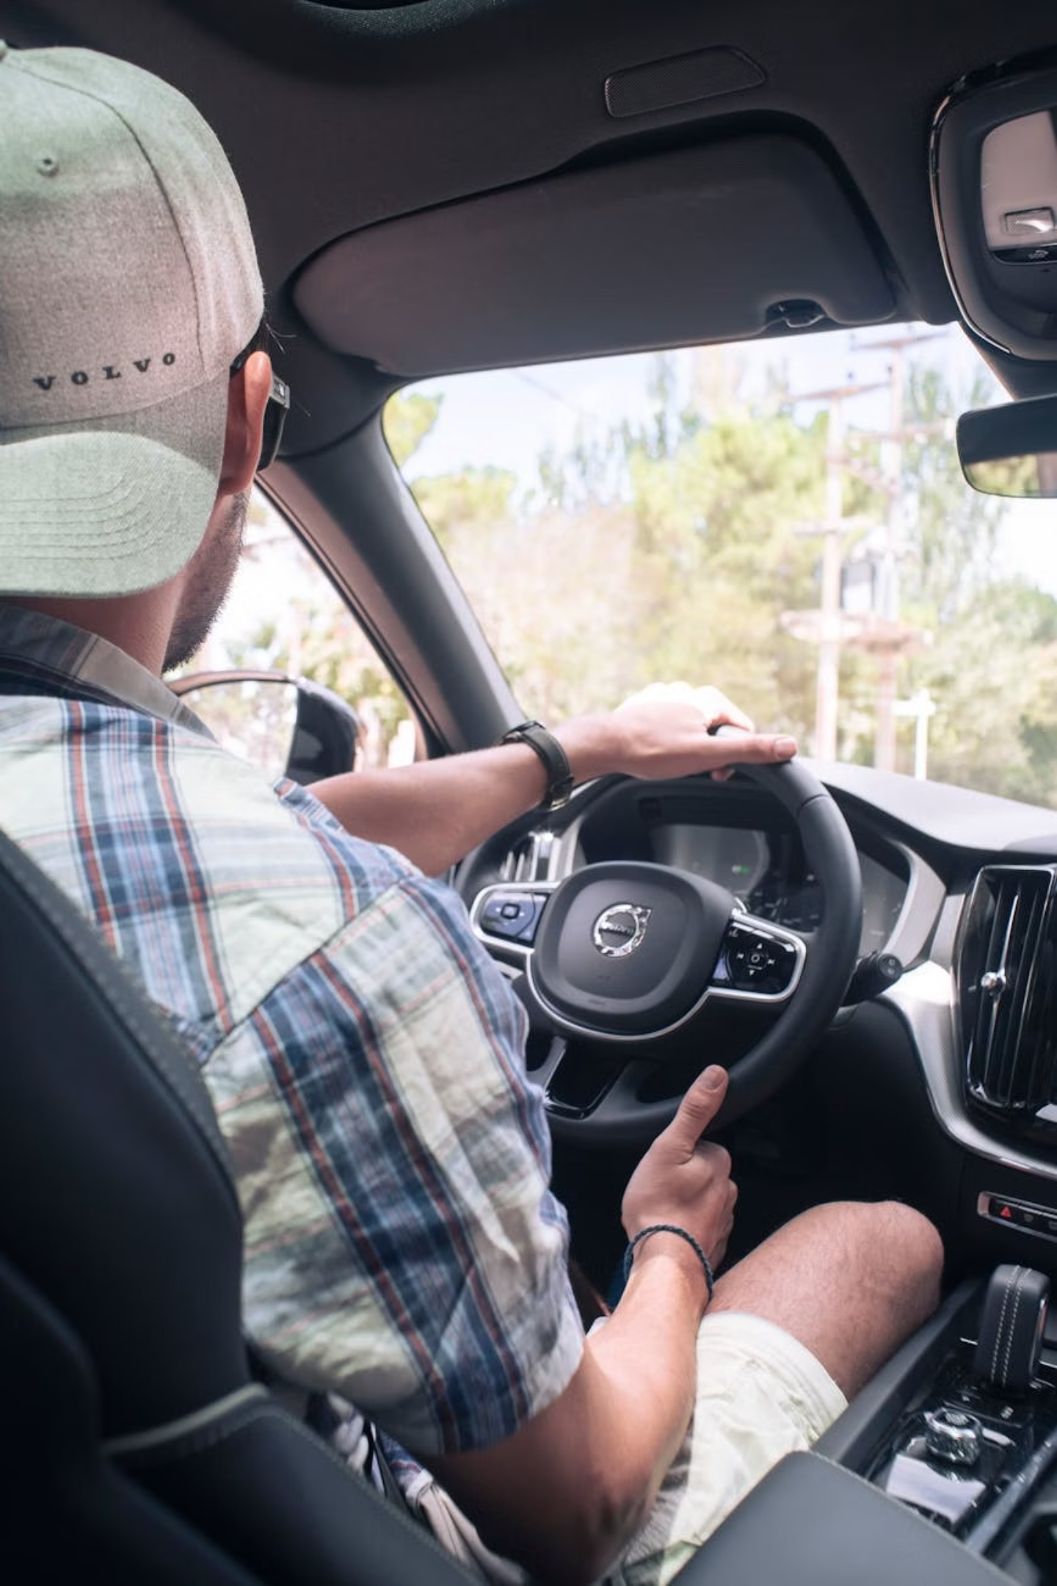
Hybrid Driver Behavior Monitoring: A Unified Solution
This presentation introduces a comprehensive Hybrid Solution, merging B2B and B2C technologies, designed to prevent road accidents by analyzing driver behavior before incidents occur.
Our unique approach integrates real-time individual safety with large-scale behavioral analysis, offering a robust framework for accident prevention.

Slide 2

Engineering Perspective: Categories of Driver-Related Accidents
1. Driver Distraction
2. Driver Drowsiness
Loss of sustained attention
Characteristic eye closure patterns
Deviant head or gaze direction
Identifiable yawning behavior
Manual interaction with in-cabin objects
Cumulative fatigue indicators over drive duration
Environmental engagement deviations
Micro-sleep episodes detection
This category encompasses situations where the driver's focus is diverted from the primary task of driving.
Drowsiness refers to the physiological state of impaired alertness, leading to reduced reaction times and cognitive function.

Slide 3
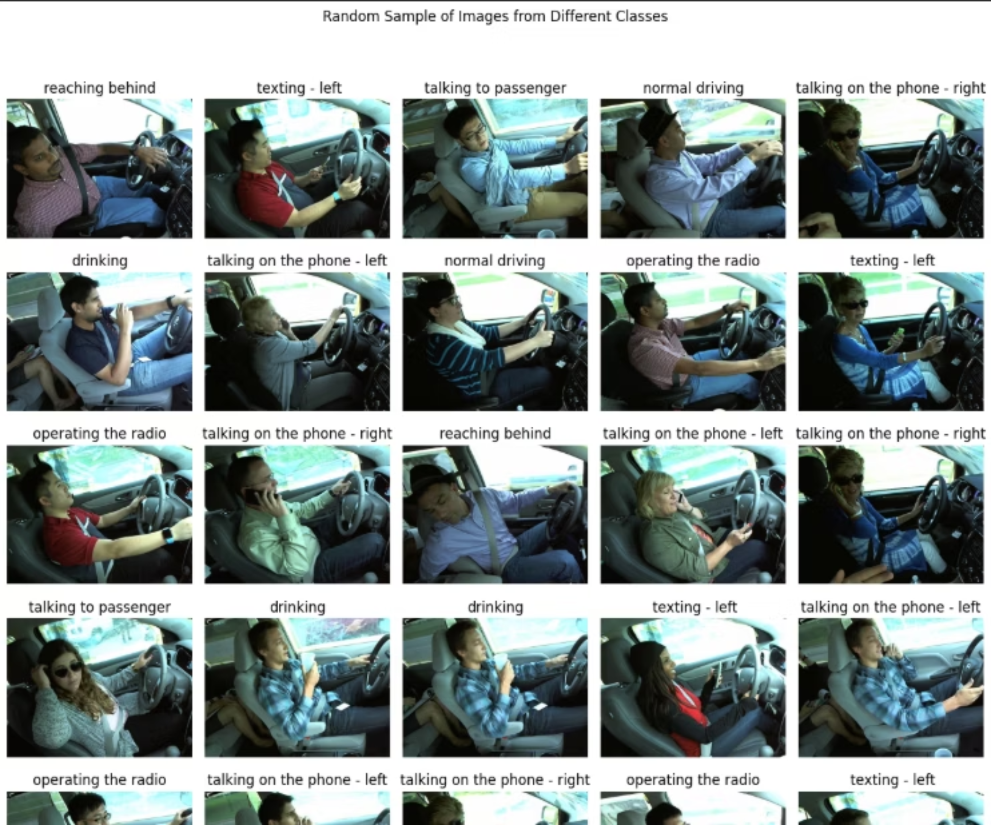
Display Random Samples

Slide 4
Driver Distraction Monitoring System (B2B)
(1) Training
(2) Model Definition
(3) Inference + UI

Slide 5
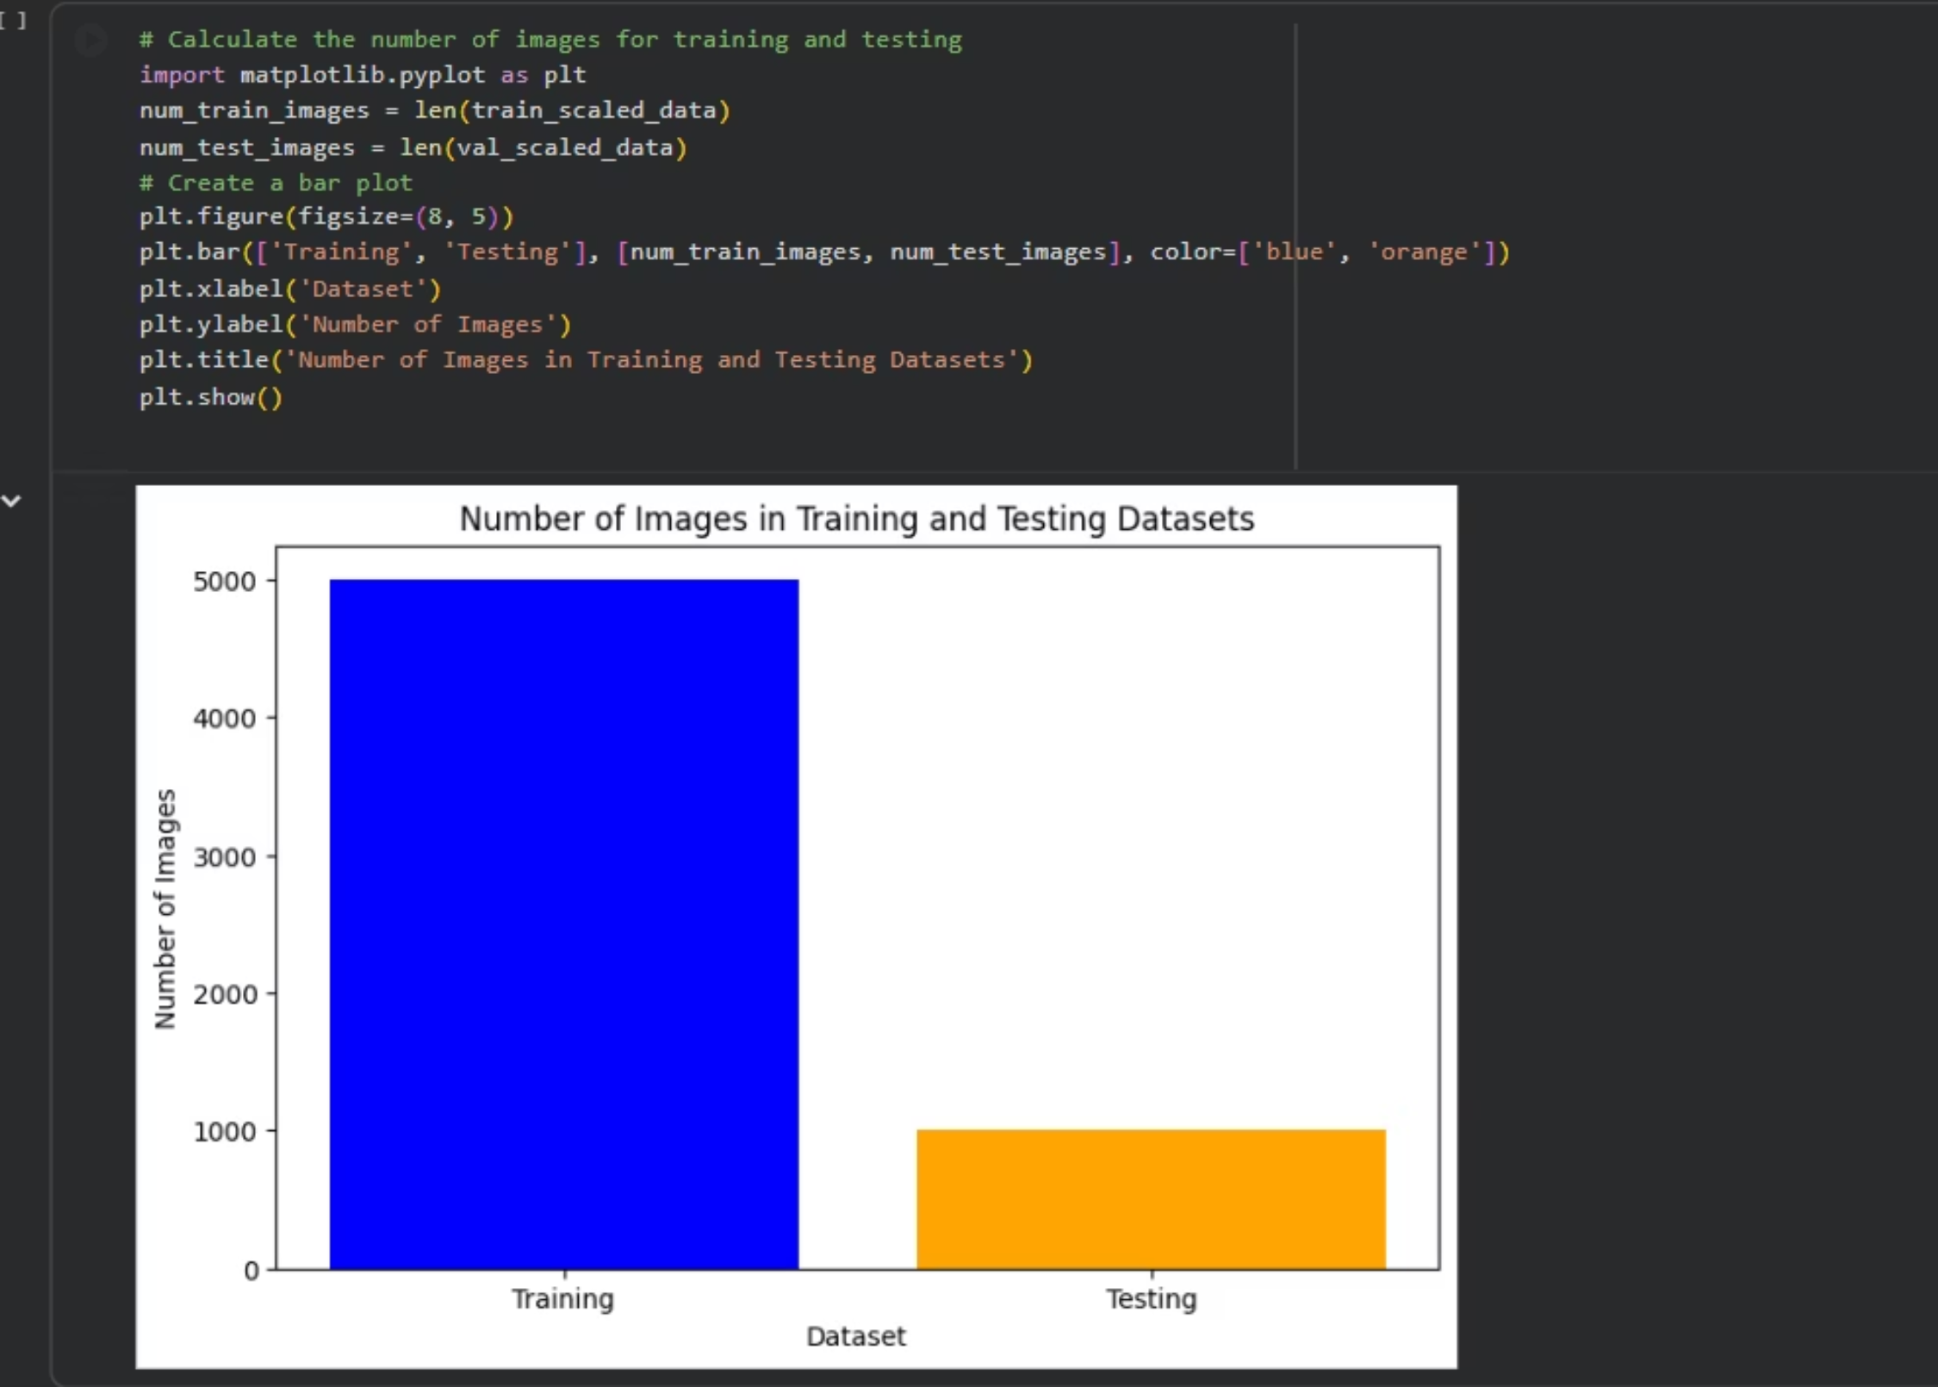
show the spliting Ratio
For Training & Testing

Slide 6
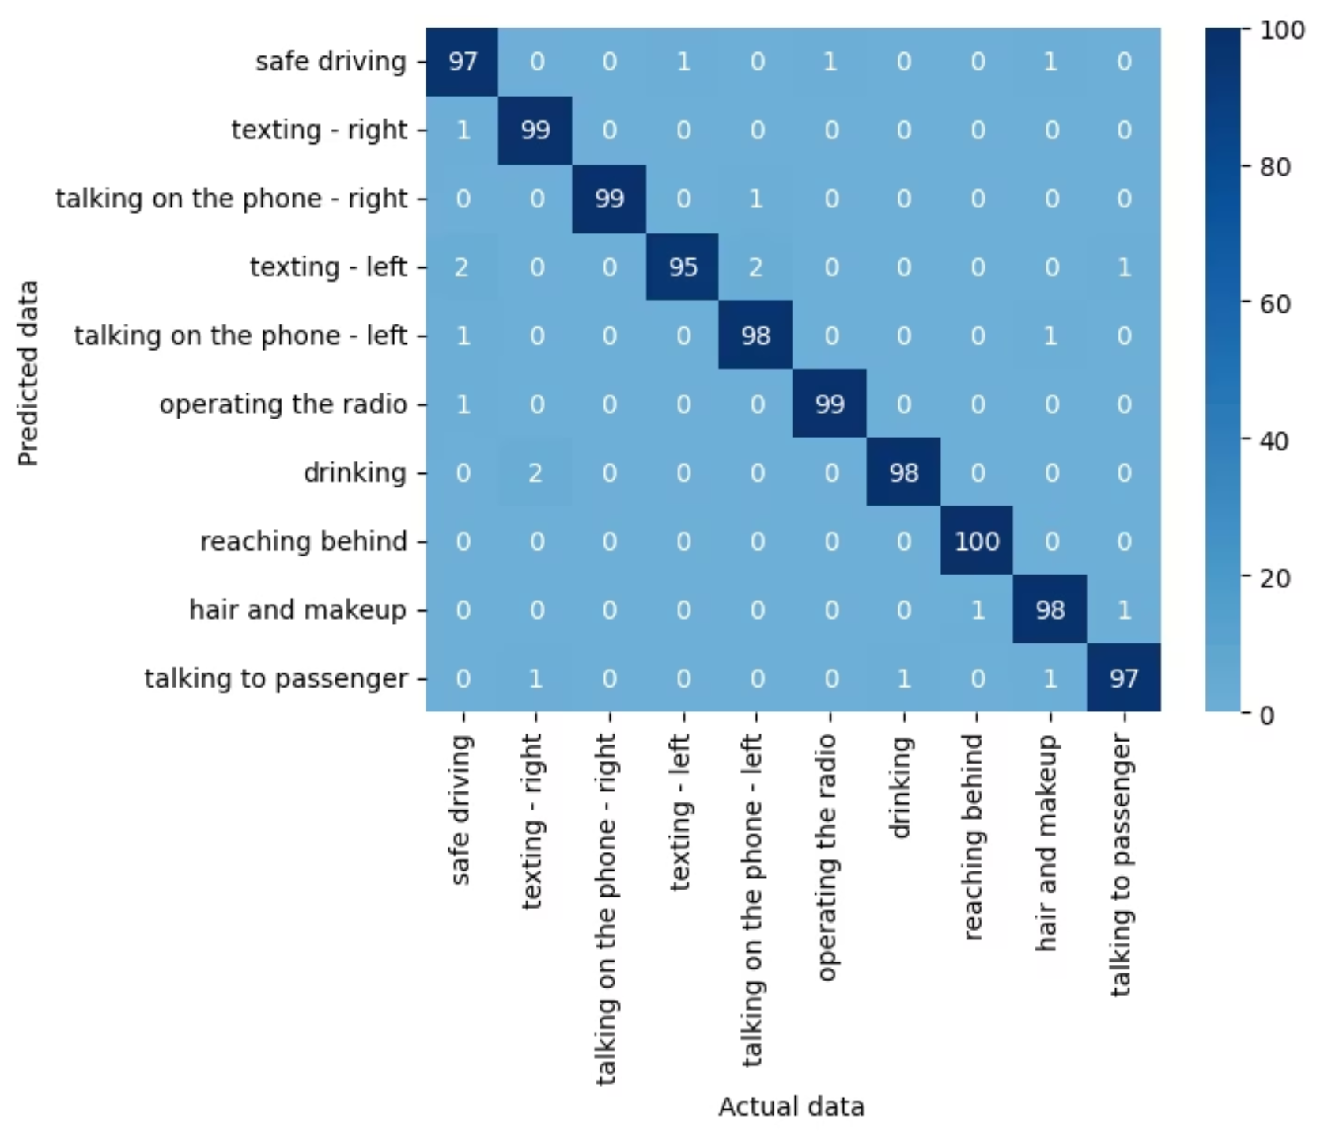
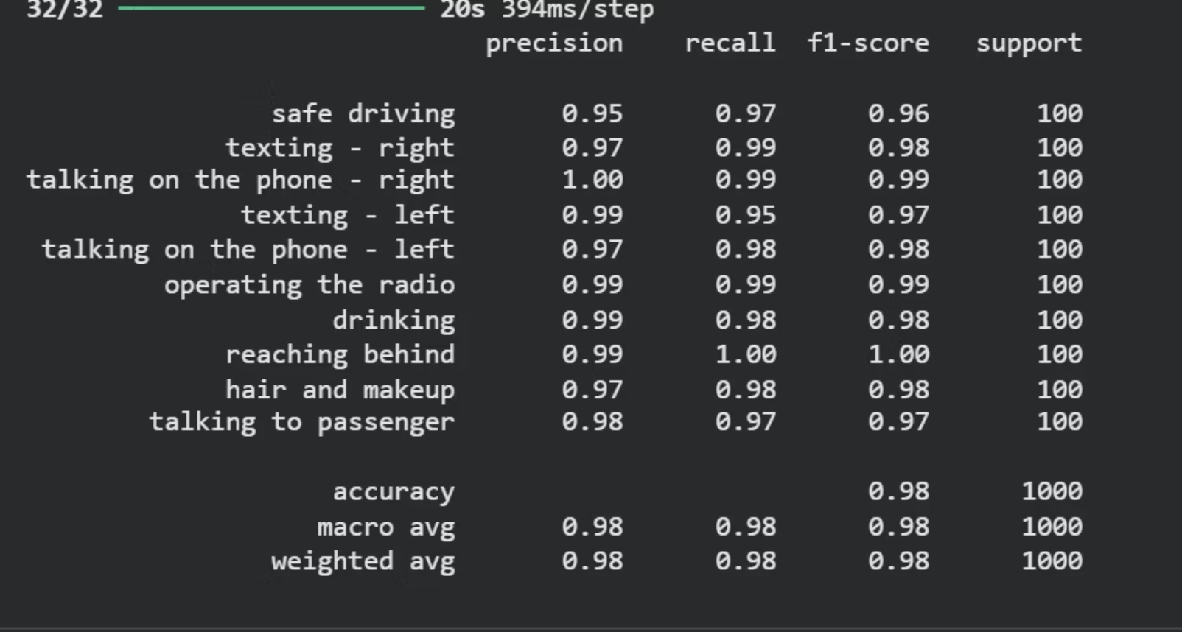
Acc and Confuction Matrix

Slide 7
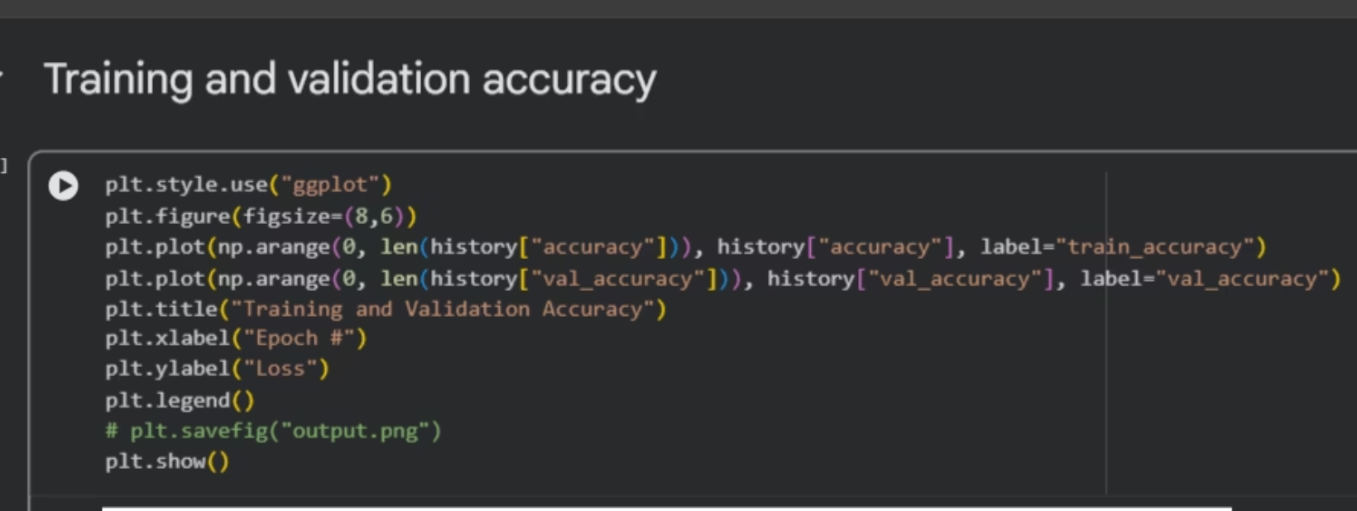
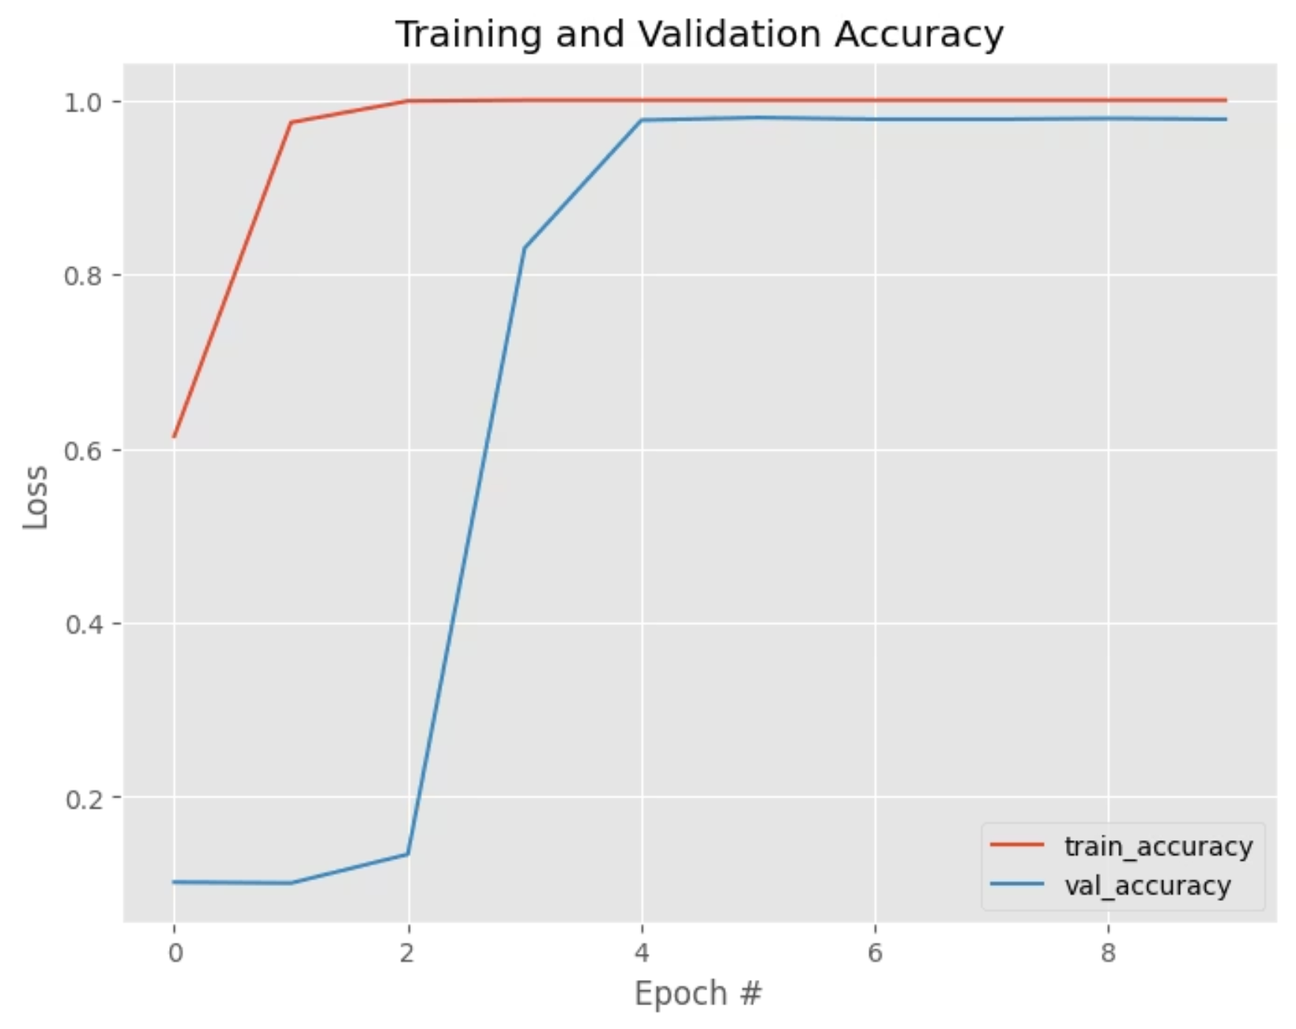
Training And Validation Accuracy

Slide 8
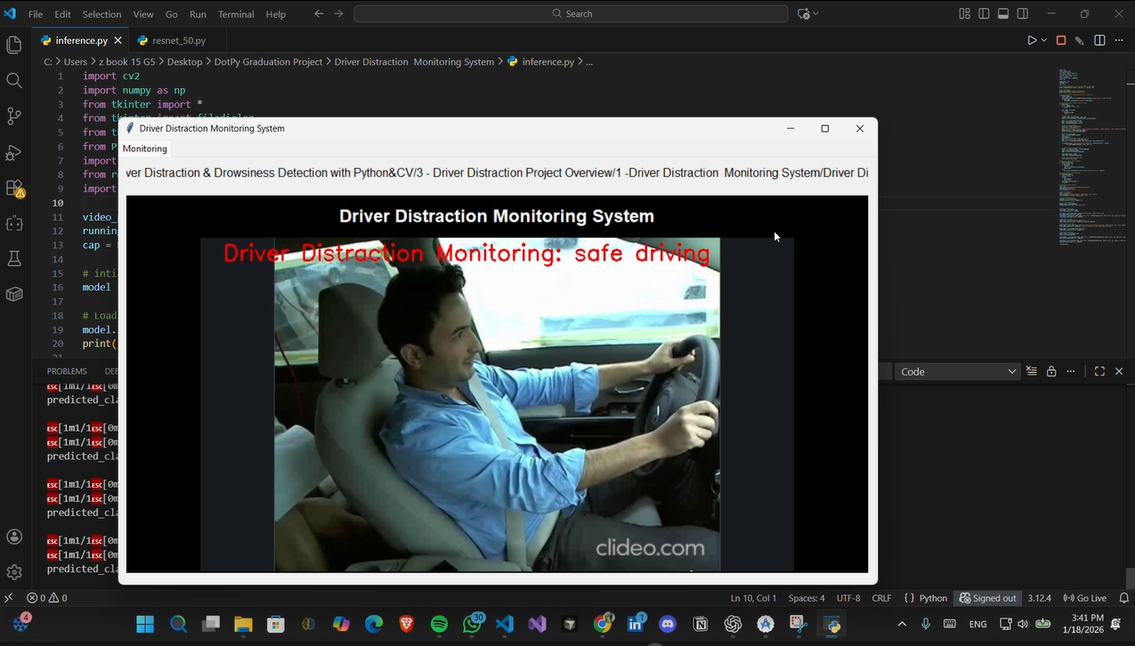
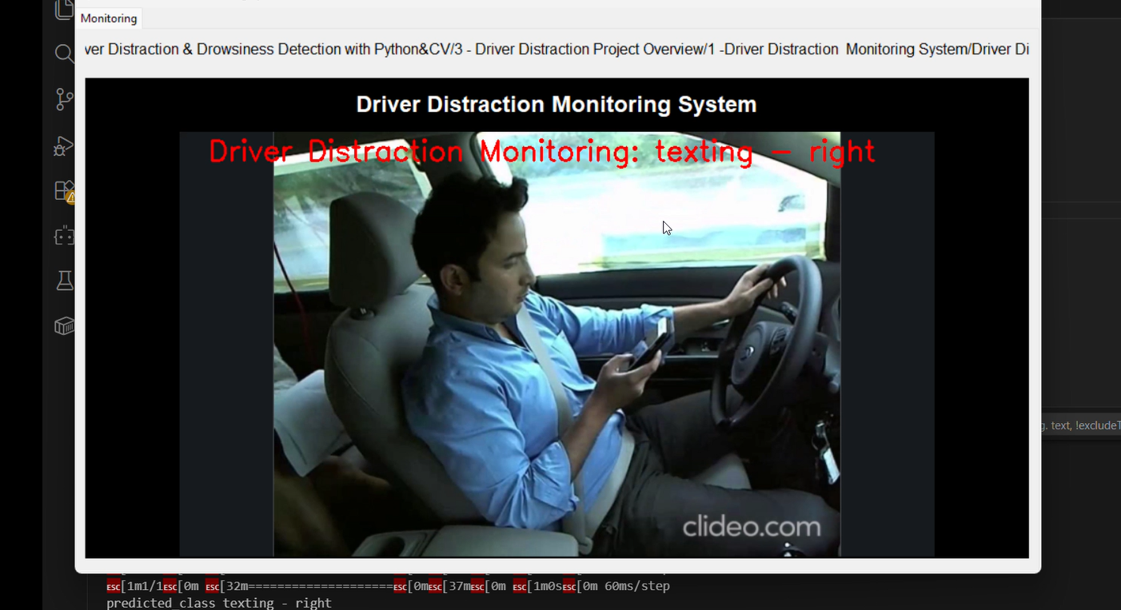
The Result

Slide 9
Python + MediaPipe (Eye Closure Detection)
MediaPipe is a Google-ready framework that uses Computer Vision to extract facial features in real time.
468 landmarks appear on the face
Eye closure detection was implemented using MediaPipe Face Mesh, which provides real-time facial landmarks. Eye Aspect Ratio was calculated geometrically to detect prolonged eye closure without relying on a trained deep learning classifier.

Slide 10
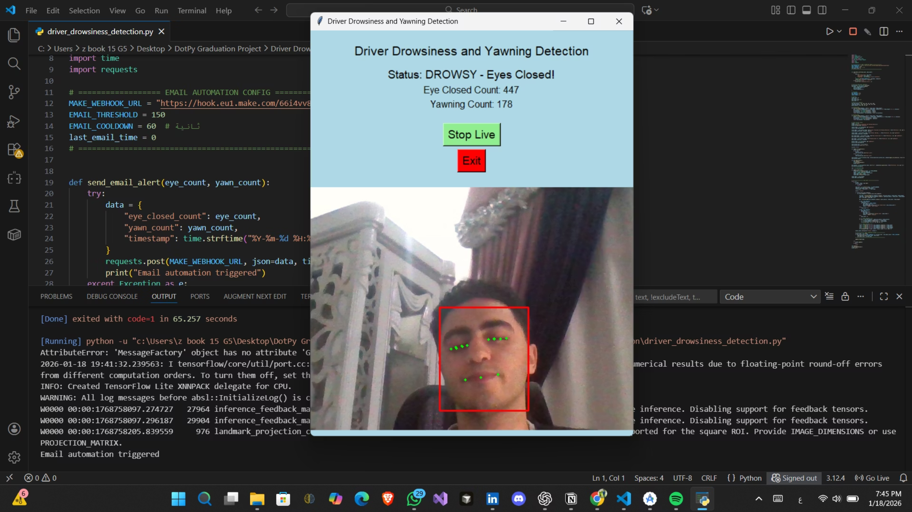
Running the Code
Count Numbers ber Fram
For Eye & Mouce

Slide 11
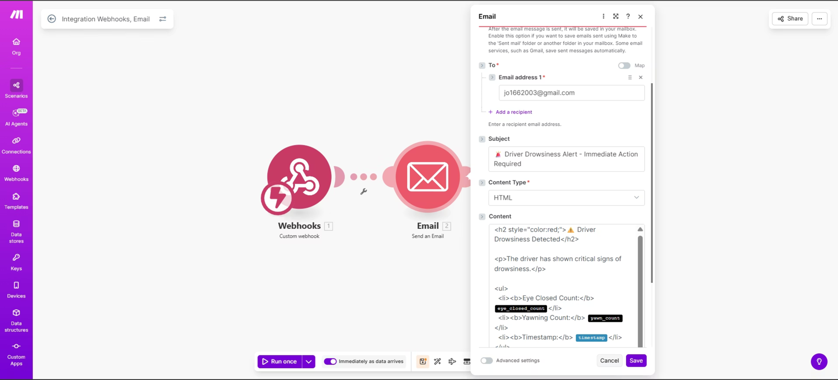
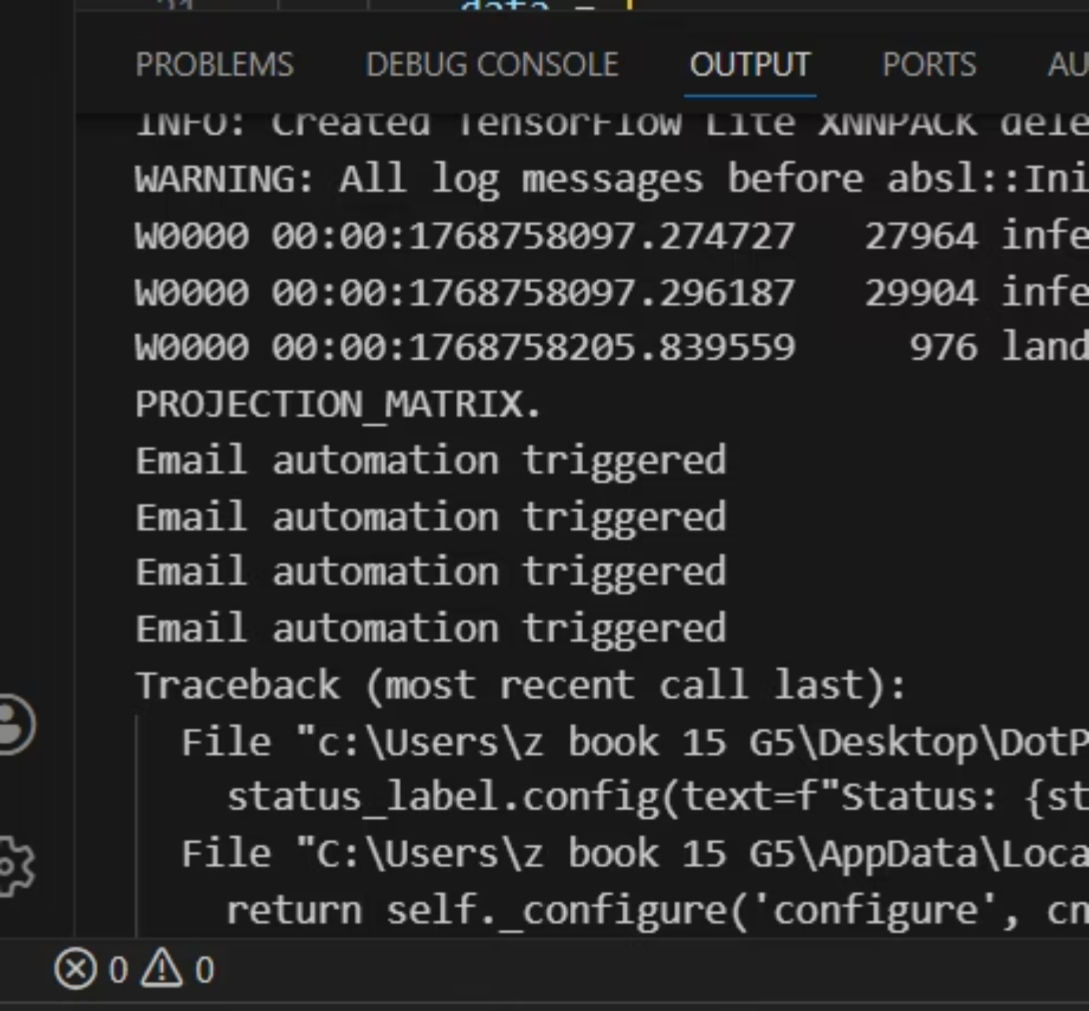
Codition to operate The Automation (Phone Call & Email)
if the Counter Reached 150
the Automation Started to Send Emails

Slide 12

Driver Drowsiness Detection Mobile App (B2C)
& Python MediaPipe
Real-time Fatigue Detection
Key Signals for Drowsiness
This dedicated system provides instantaneous fatigue detection directly to individual drivers, functioning as a critical personal safety tool.
Dynamic eye open probability (EAR - Eye Aspect Ratio)
Detection of characteristic yawning behavior
Analysis of temporal patterns in facial expressions
Android Native Development
Head pose estimation for nod detection
These physiological and behavioral cues are continuously monitored to assess driver alertness.
Android application using Kotlin.
CameraX Integration
Utilizes CameraX API for efficient, real-time camera stream access and processing.
Google ML Kit for Analysis
Incorporates Google ML Kit for robust face detection and analysis capabilities.

Slide 13


Slide 14
Thank You

